Slide 1
From Science, Computer Science, to Software Security
Computer Security: Techniques and Tactics

Slide 2
Logistics
Course Website:
https://www.tiffanybao.com/courses/cse591/
Schedule by the first project cycle will be on soon.
I will announce when it is ready.
Done with submitting your favorite projects?
Topic Presentation: Starting with next Monday (Jan 14th)
Teams are encouraged to come to my office hour for more project information.

Slide 3
Logistics
Topic Presentation
Encouraged to use this template.
Improvements are welcome. If you:
Improve the template
Correct the website,
and I take your improvement, you will get a candy. ☺

Slide 4
Science
From the Latin word scientia, meaning "knowledge"
Science is a set of knowledge statements.
Two types of knowledge claims:
Deductive statement and Inductive statement
https://www.freepik.com/free-photos-vectors/science

Slide 5
Deduction
Produces statements that follow with certainty from a self-consistent set of axioms
Examples?
Notes:
Euclidean geometry

Slide 6
Induction
Draw conclusions about the empirical world using observations and inferences from those observations
Conclusions include more than observations
Examples?
Question: Is computer science deduction or induction?

Slide 7
Deduction v.s. Induction
Deductive statements: Certain consequences of the premises
Inductive statements: Always subject to error
Pure deduction offers no route to reliable knowledge about the world
Induction, does allow general statements about the world, but we can never be sure that they are true
Einstein:
“As far as the laws of Mathematics refer to reality they are not certain, and as far as they are certain they do not refer to reality.”

Slide 8
Computer Science --- Turing Machine

Slide 9
Turing Machine
Inductive Statement:
A Turing machine can compute any problem.
Is this correct?

Slide 10
Halting Problem
Given: A program P, an input to the program, I
Produce: Whether the program P will eventually halt when P runs with the input I.
while (1)
continue;
if (strcmp(input, “exit” == 0)
return 0;

Slide 11
Halting Problem
A general algorithm to solve the halting problem for all possible program-input pairs cannot exist.
Alan Turing, 1936
Notes:
a mathematical definition of a computer and program, which became known as a Turing machine;
the halting problem is undecidable over Turing machines.

Slide 12
Halting Problem
Program P
Input I

Slide 13
Halting Problem
Program P
Program P

Slide 14
Halting Problem
Program P
Program P
function K(i):
if H(i,i) = halt then
loop
else
halt
Consider H(K,K)

Slide 15
Computing Complexity

Slide 16
Software Security
… it’s all about bugs.
Find bugs, deal with bugs, and live with bugs.

Slide 17
Software Security
Find Bugs
(Techniques)
Deal with Bugs
(Tactics and Techniques)
Notes:
The answer is that we need to consider them together, as

Slide 18
Software Security
Requires Technical Knowledge
Find Bugs
(Techniques)
Deal with Bugs
(Tactics and Techniques)
Notes:
A decision -> skill level of binary analysis
optimal decision -> how good we are at binary analysis
and this requires security domain knowledge
e.g. patch-based exploit generation

Slide 19
Software Security
Find Bugs
(Techniques)
Deal with Bugs
(Tactics and Techniques)
Directs Techniques In Need
Notes:
On the other hand
Techniques can benefit from decisions
decision directs…
so that we can develop techniques more specifically

Slide 20
The Future of Software Security: Cyber Autonomy
To build a framework to systematically reason about how to mitigate software vulnerabilities
To provide a holistic approach to software security study
Update Optimal Decision
Updated Decision
Find Bugs
(Techniques)
Deal with Bugs
(Tactics and Techniques)
New Technique
Develop New Techniques
Notes:
I do both techniques and decision.
Moreover, I connect techniques and decision together

Slide 21
Finding Bugs
A general algorithm to solve the halting bug hunting problem for all possible program-input pairs cannot exist.
Alan Turing, 1936

Slide 22
Finding Bugs
Program P
Program P
function K(i):
if V(i,i) = bug then
exit
else
vuln()
Consider V(K,K)

Slide 23
Finding Bugs
Sounds very pointless.
Why are we still doing research on this?

Slide 24
More about Finding Bugs
Please refer to the topic presentation of Project 1!
(Next Monday 1/14)
Expectations:
1. Static approaches:
Program verification
2. Dynamic approaches:
Taint analysis, symbolic execution, fuzzing

Slide 25
Now Let’s Suppose We Find a Bug
Post to bug bounty
A new status at FB
Sell to government
Leave it alone
We: you and me, a company, a country.

Slide 26
What Should We Do?
Should we disclose?
Should we attack our adversaries (assuming attacking is legitimate)?
Should we do nothing?
Notes:
Yes and No?

Slide 27
What Should We Do Now?
2012
NSA discovered the vulnerability
Jan 2017
NSA learned about a possible leak
Feb 2017
NSA disclosed the vulnerability
Mar 2017
Microsoft released the patch
May 2017
WannaCry attack started
* https://boot13.com/windows/timeline-nsa-hacking-tool-to-wannacry
Notes:
the wannacry attack reveals two issues in software security

Slide 28





Modeling Decision Making Process
Strategy 1
Strategy 2
x 5
x 1
What benefit does a threat actor gain by exploiting this vulnerability?
x 2
x 2
x 3
x 2
Notes:
Suppose we are making our decision
When we make our decision, we consider many factors, such as.
And when we consider this factor, we are imagining an opponent
If we are offender, we may also attack our opponent, and thus we need to consider his computing resources

Slide 29
Modeling Decision Making Process
Strategy 1
Strategy 2
A Decision is made based on a Multi-agent Game
x 5
x 1
x 2
x 2
x 3
x 2

Slide 30
Multi-agent Single-round Game
Player 1
Player 2
Not discovered
Discovered
Not discovered
Discovered
Nop
Withhold
Attack
Patch
Nop
Withhold
Attack
Patch
Vulnerable Resources
Vulnerable Resources
Notes:
Abstractly,
There is no apparent answer for which action to choose when discover a vulnerability, as all actions have side effects.

Slide 31
Actions over Time: Repeated Game
Player 2 withholds
Player 2 attacks
Timeline
Player 1 attacks
Player 1 attacks again
Notes:
In the single round model, players are only allowed to make one actions at same time
multiple actions, not at the same time

Slide 32
What to Consider
Ambassador
Network Dude
Meister
Scriba
Worker
Poll Creator
AFL
Driller
Tester
Rex
POV Fuzzer
Farnsworth
Patcherex
Colorguard
POV Tester

Slide 33
What to Consider
Ambassador
Network Dude
Meister
Scriba
Worker
Poll Creator
AFL
Driller
Tester
Rex
POV Fuzzer
Farnsworth
Patcherex
Colorguard
POV Tester
Patch
Attack

Slide 34
Player Model
Discovery vulnerability by oneself
Detect exploits from the others
Obtain patches from the others
Vulnerability Awareness
Patch Generation
Exploit Weaponizing
Patch
Exploit

Slide 35
Player Model
Player
Discover by self
Exploit Generation
Attack
Observe disclosure from the others
Patch-based Exploit Generation
Patch
Detect exploits from the others
The Ricochet Attack
Player’s Machines

Slide 36
Finding Nash Equilibrium
Nash Equilibrium: the strategy profile where all players will not change their strategy even they know the other player’s strategy.
Computing Nash Equilibrium is a PPAD (Polynomial Parity Arguments on Directed graphs) problem.
NP
P
PPAD

Slide 37
How to Deal with Bugs
Sounds pointless, again.
Why are we still doing research on this?

Slide 38
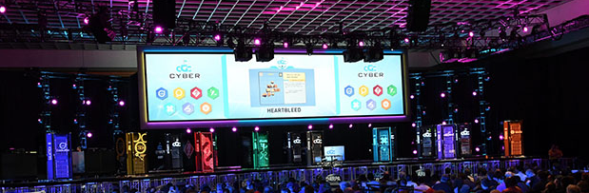
Cyber Grand Challenge
First Place: $2,000,000
Second Place: $1,000,000
Third Place: $750,000

Slide 39
Tactics Matters
First Place: $2,000,000
Second Place: $1,000,000
Third Place: $750,000
, if you choose not to attack or patch.

Slide 40
Real World
National Security Agency discloses 91% of the zero-day vulnerabilities (that it discovers in software made and/or used in the U.S. to developers).
Admiral Michael Rogers

Slide 41
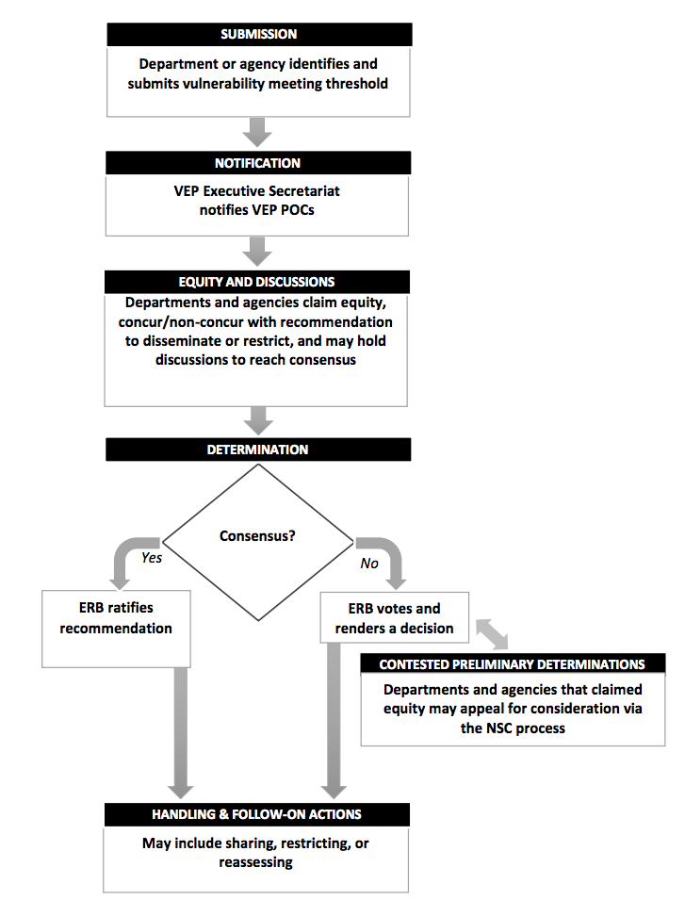
5 business days
7 business days
5 business days
7 business days
Vulnerabilities Equities Process

Slide 42
Things to Consider
How much is the vulnerable system used in the core internet infrastructure, in other critical infrastructure systems, in the U.S. economy, and/or in national security systems?
Does the vulnerability, if left unpatched, impose significant risk?
How much harm could an adversary nation or criminal group do with knowledge of this vulnerability?
How likely is it that we would know if someone else was exploiting it?
How badly do we need the intelligence we think we can get from exploiting the vulnerability?
Are there other ways we can get it?
Could we utilize the vulnerability for a short period of time before we disclose it?
How likely is it that someone else will discover the vulnerability?
Can the vulnerability be patched or otherwise mitigated?

Slide 43
Involved Departments / Offices
Office of Management and Budget
Office of the Director of National Intelligence
Department of the Treasury
Department of State
Department of Justice
Department of Homeland Security
Department of Energy
Department of Defense
Department of Commerce
Central Intelligence Agency

Slide 44
The Future of Software Security: Cyber Autonomy
To build a framework to systematically reason about how to mitigate software vulnerabilities
To provide a holistic approach to software security study
Update Optimal Decision
Updated Decision
Find Bugs
(Techniques)
Deal with Bugs
(Tactics and Techniques)
New Technique
Develop New Techniques
Notes:
I do both techniques and decision.
Moreover, I connect techniques and decision together

Slide 45
In-Class Test
Which is the following does NOT contain inductive reasoning:
Computer Science
Physical Science
Social Science
Math Science

Slide 46
Your TODOs
Project 1: 1/14
SOK: (State of) The Art of War: Offensive Techniques in Binary Analysis
Project 6: 1/16
Before We Knew It : An Empirical Study of Zero-Day Attacks In The Real World
Get ready! Not a single-paper presentation! Send me the read list before topic presentation.
Check emails for teaming result by today
Check course website for
Topic presentation schedule
Seed papers

Slide 47
Questions?

